Slide 1

Yelp Recommendation Engine
IST718 Big Data Analytics
Team Members: Kabir Thakur, Himanshu Mangal, Pankaj Yadav, Jenil Sheth

Slide 2
Why Recommendation Engine
Increase user engagement: Encourage users to stay on the platform longer by providing personalized recommendations that match their interests.
Improve user experience: Provide a seamless experience for users, where they can easily find relevant content and products based on their preferences and behaviors.
Improve user retention: Encourage users to keep using the platform by providing recommendations that are accurate, useful, and personalized.
Improve product discovery: Help users discover products or services they may not have otherwise found by providing personalized recommendations based on their browsing and purchase history.

Slide 3
Dataset Overview
The Yelp reviews dataset is a collection of user reviews of businesses in Yelp.
The dataset contains over 8 million reviews and is labeled with the corresponding rating (1-5 stars) given by the reviewer.
The dataset also includes other information such as the text of the review, the business category, and the geographical location of the business.
We are currently using 3 different data files to obtain this dataset.
Businesses: 150346 records
Users: 1987896 records
Reviews: 6990280 records

Slide 4
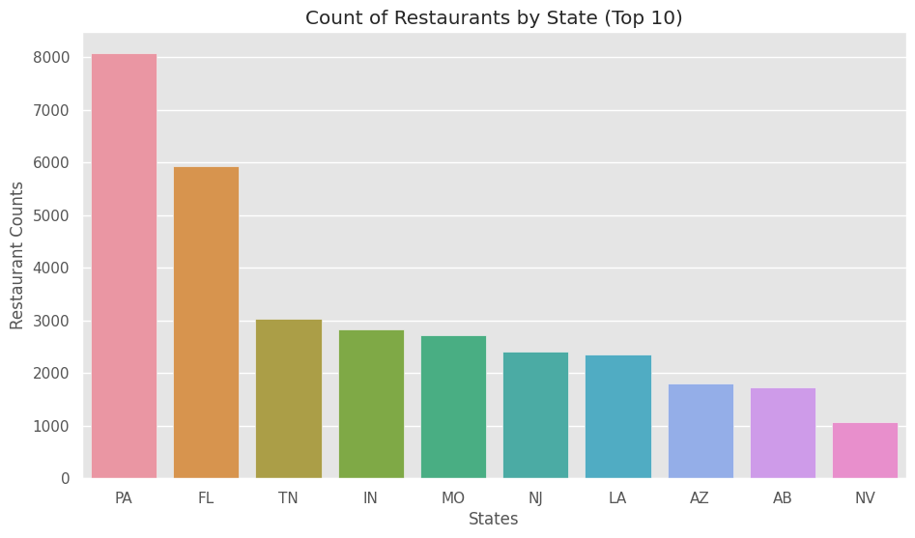
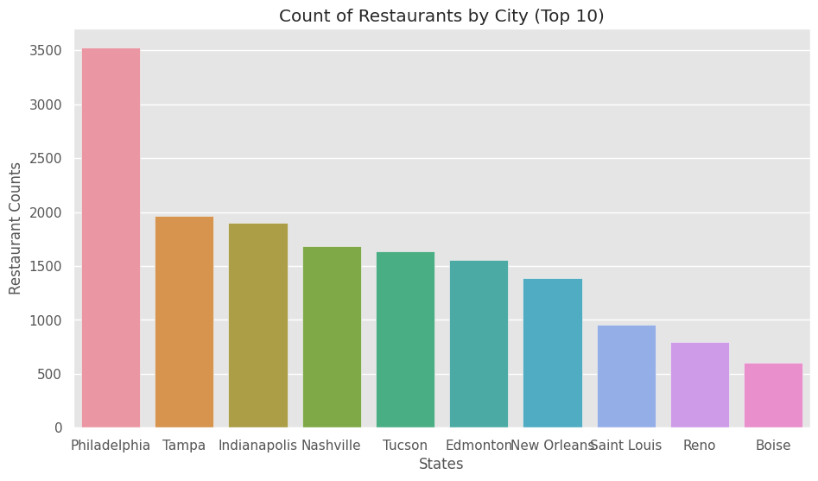
Restaurants Distribution
Based on the analysis, Pennsylvania state has the highest count of restaurants, and among the top 10 cities in the USA with the most restaurants, Philadelphia stands out significantly.

Slide 5
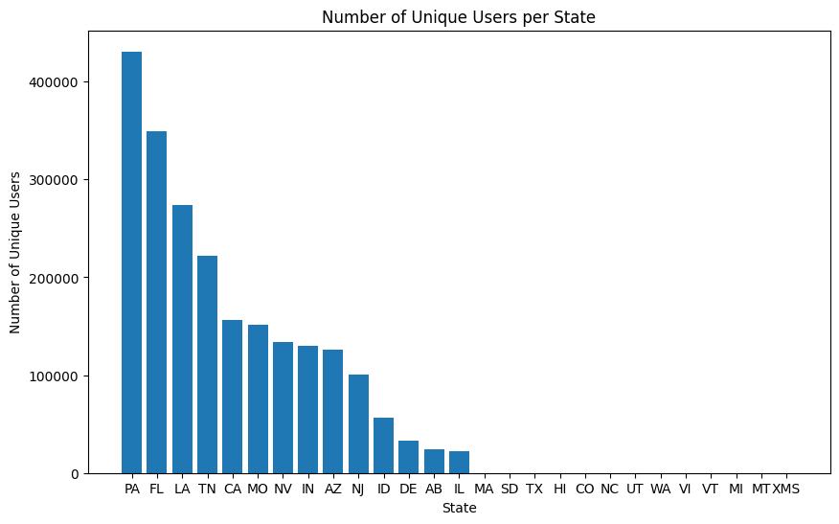
Unique Users in Each State

Slide 6
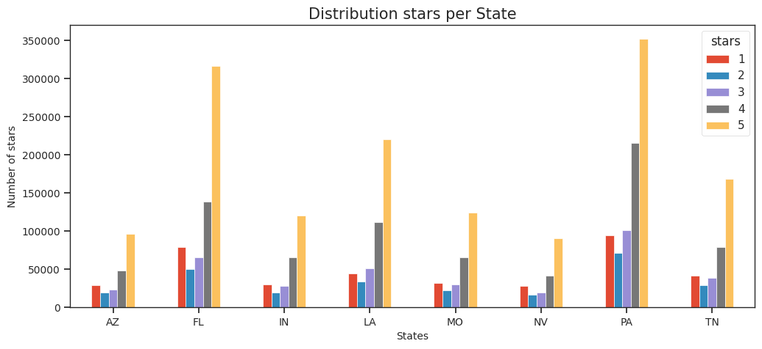
Restaurants Stars Distribution per State
According to the data, Pennsylvania (PA) received the largest number of 5-star ratings, with Florida (FL) coming in second place. These results are consistent with the proportion of restaurants per state that we observed earlier.

Slide 7
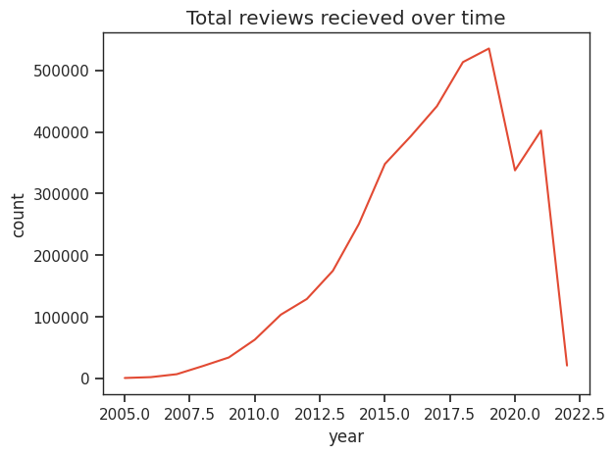
Reviews Trend
It appears that 2017 had the highest number of received reviews. Additionally, there was exponential growth in the number of reviews from 2010 to 2016. One possibility is that there was an increase in the use of online review platforms, which may have made it easier for people to leave reviews. This could have resulted in a higher volume of reviews overall, and particularly in 2017 when the platform may have reached peak popularity.
However, we can observe a steep decrease in the reviews as of 2019, this could be because of COVID-19 when people stater of avoid going out and started to social distance.

Slide 8
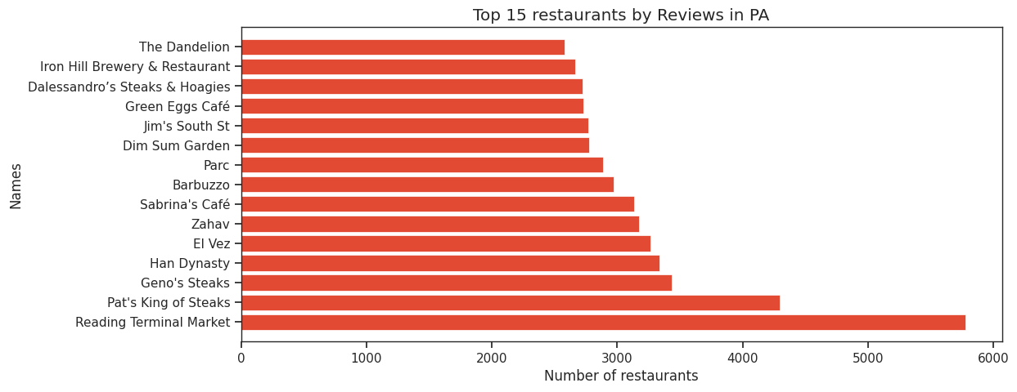
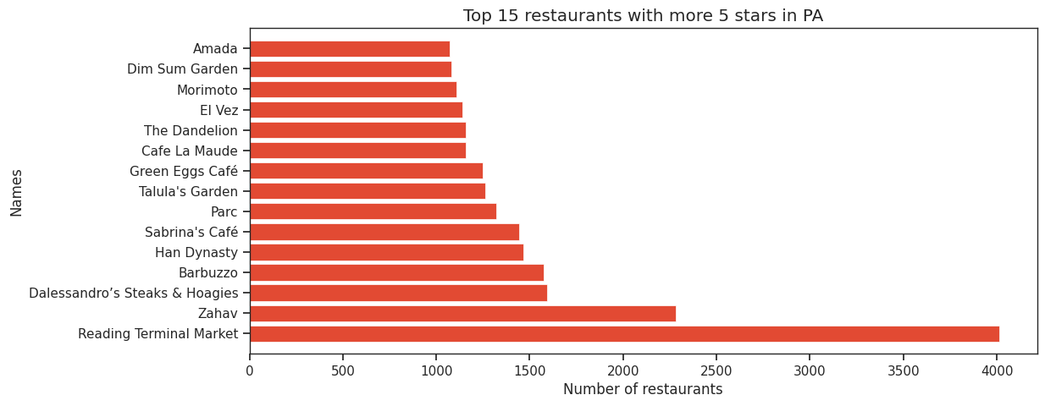
Top Restaurants in Pennsylvania

Slide 9
Data
|-- address: string (nullable = true)
|-- attributes: struct (nullable = true)
| |-- RestaurantsTakeOut: string (nullable = true)
| |-- Smoking: string (nullable = true)
| |-- WheelchairAccessible: string (nullable = true)
| |-- WiFi: string (nullable = true)
|-- business_id: string (nullable = true)
|-- categories: string (nullable = true)
|-- city: string (nullable = true)
|-- hours: struct (nullable = true)
|-- latitude: double (nullable = true)
|-- longitude: double (nullable = true)
|-- name: string (nullable = true)
|-- postal_code: string (nullable = true)
|-- review_count: long (nullable = true)
|-- stars: double (nullable = true)
|-- state: string (nullable = true)

Slide 10
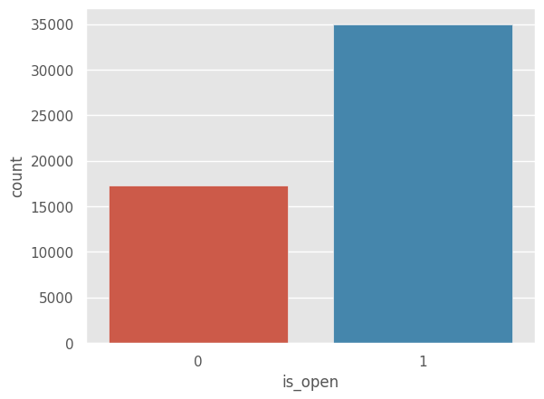
Data Cleaning
Since we are dealing with a huge dataset, we have chosen to work with only the restaurants.
The dataset has restaurants which have been closed so we have filtered those out.
To further reduce the size of our dataset so that we can run models on google colab we have chosen to work with only the state Pennsylvania. The model however is generalised and can work with the entire dataset. There are about 8000 restaurants in Pennsylvania which are currently open.

Slide 11
Recommendation Engine
We are using the k-means algorithm to cluster businesses together and then recommend users businesses based on the cluster they prefer.
We also clustered users based on the aggregate of categories of restaurants they have visited.
Within a cluster, the recommendations will be based on the location closest to each user. User location has been calculated based on mean of locations of the businesses visited by each user.

Slide 12
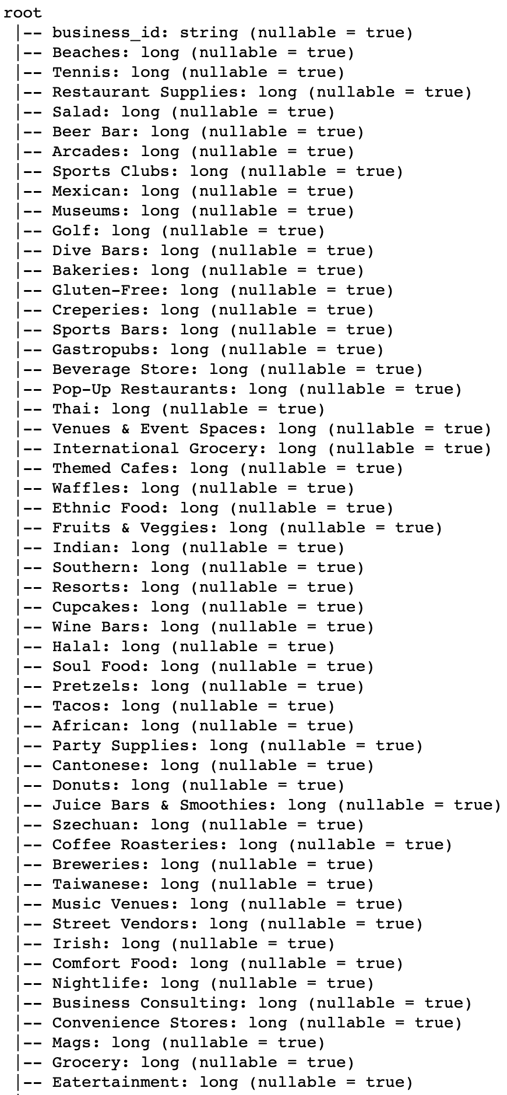
Features
Each business has multiple features.
For now we are clustering businesses based on categories. There are 447 distinct categories for restaurants in the dataset. Each business has multiple categories.
The categories are 'Bed & Breakfast', 'Mexican', 'Ethiopian', 'Breweries', 'Waffles' etc
These categories have been one hot encoded and we created a list of businesses with these features.
Out of 447 categories, there are many that appear only a few times. We have taken a cut off of at least 10 restaurants in each category. We are left with 156 features.

Slide 13
Additional Features
As additional features of each business
Star rating and review counts?
Attributes
Working Hours

Slide 14
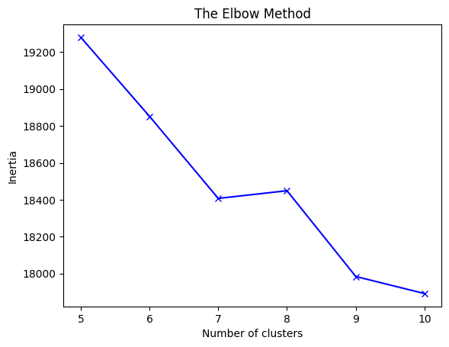
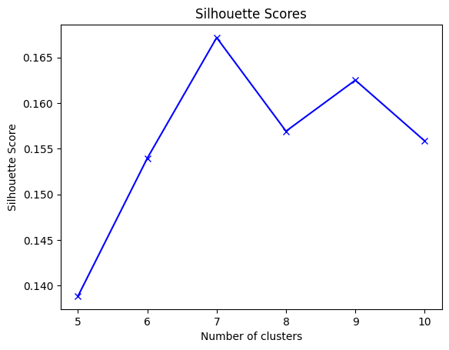
Clustering Businesses (8069, 156)

Slide 15
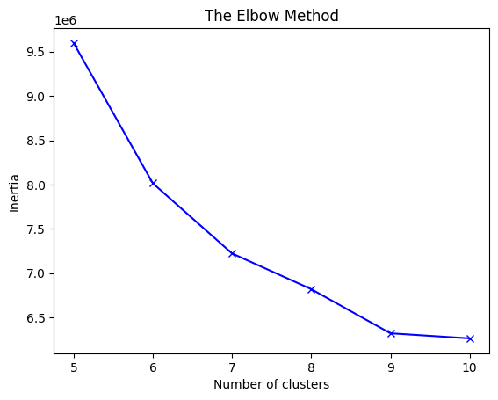
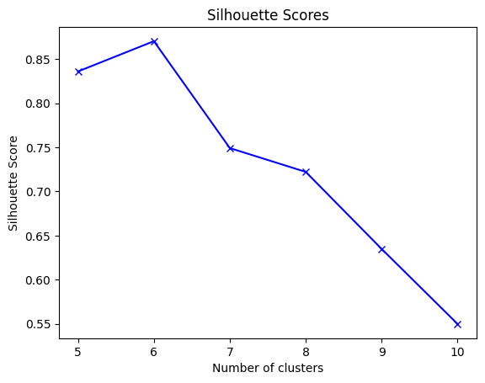
Clustering Users (269462, 156)

Slide 16
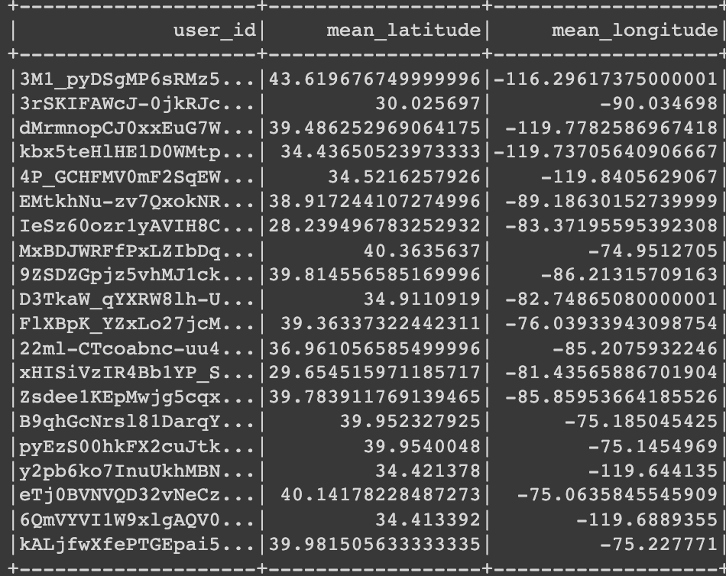
Next Steps
K-means on business
Recommendations
Sort by distance
Recommendations
K-means on Users
Recommendations to user

Slide 17
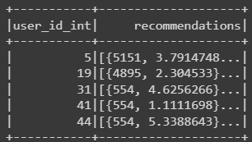
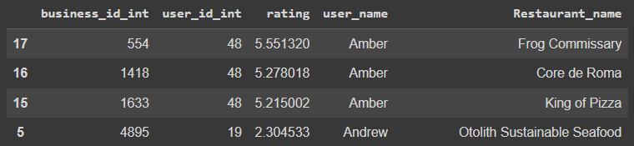
Alternating Least Squares (ALS)
Train Test Split: 70:30
Results:
RMSE: 1.301653214038206
Notes:
The ALS algorithm is a way to recommend things to people based on their past behavior. For example, it can be used to recommend movies to users based on their past movie ratings.
To do this, ALS represents users and movies as vectors in a special "hidden space" that's not directly observable. These vectors are called "latent factors". The ALS algorithm learns what these latent factors should be by looking at the past ratings that users have given to movies.
The key idea is that if two users have similar ratings for some movies, then their latent factor vectors in this hidden space should be similar as well. Similarly, if two movies have similar ratings from users, then their latent factor vectors should be similar too.
Once the algorithm has learned these latent factor vectors, it can predict how a user would rate a movie they haven't seen yet by taking the dot product of the user's latent factor vector and the movie's latent factor vector. The predicted rating is then used to recommend movies to the user.
To train the ALS algorithm, it tries to minimize the difference between the predicted ratings and the actual ratings in the training data. This is done by adjusting the latent factor vectors until the difference is as small as possible

Slide 18
Thank you

